Slide 1
Digital Speech Processing—
Lecture 1
Introduction to Digital Speech Processing

Slide 2
Speech Processing
Speech is the most natural form of human-human communications.
Speech is related to language; linguistics is a branch of social science.
Speech is related to human physiological capability; physiology is a branch of medical science.
Speech is also related to sound and acoustics, a branch of physical science.
Therefore, speech is one of the most intriguing signals that humans work with every day.
Purpose of speech processing:
To understand speech as a means of communication;
To represent speech for transmission and reproduction;
To analyze speech for automatic recognition and extraction of information
To discover some physiological characteristics of the talker.

Slide 3
Why Digital Processing of Speech?
digital processing of speech signals (DPSS) enjoys an extensive theoretical and experimental base developed over the past 75 years
much research has been done since 1965 on the use of digital signal processing in speech communication problems
highly advanced implementation technology (VLSI) exists that is well matched to the computational demands of DPSS
there are abundant applications that are in widespread use commercially

Slide 4

The Speech Stack
Speech Applications — coding, synthesis, recognition, understanding, verification, language translation, speed-up/slow-down
Speech Algorithms —speech-silence (background), voiced-unvoiced decision, pitch detection, formant estimation
Speech Representations — temporal, spectral, homomorphic, LPC
Fundamentals — acoustics, linguistics, pragmatics, speech perception

Slide 5
Speech Applications
We look first at the top of the speech processing stack—namely applications
speech coding
speech synthesis
speech recognition and understanding
other speech applications

Slide 6
Speech Coding
Encoding
speech
A-to-D Converter
Analysis/ Coding
yˆ[n]
data
yˆ[n]
Bit sequence
Channel or Medium
x (t)
x[n]
Sampled signal
y[n]
Compression
c
Continuous time signal
Transformed representation
Decoding
Channel or Medium
data
speech
Decom- pression
Decoding/ Synthesis
D-to-A Converter
y%[n]
x%[n]
x% (t)
yˆ_{c} (t)
c

Slide 7
Speech Coding
Speech Coding is the process of transforming a speech signal into a representation for efficient transmission and storage of speech
narrowband and broadband wired telephony
cellular communications
Voice over IP (VoIP) to utilize the Internet as a real-time communications medium
secure voice for privacy and encryption for national security applications
extremely narrowband communications channels, e.g., battlefield applications using HF radio
storage of speech for telephone answering machines, IVR systems, prerecorded messages

Slide 8


Demo of Speech Coding
Narrowband Speech Coding:
64 kbps PCM
32 kbps ADPCM
16 kbps LDCELP
8 kbps CELP
4.8 kbps FS1016
2.4 kbps LPC10E
Wideband Speech Coding:
Male talker / Female Talker
3.2 kHz – uncoded
7 kHz – uncoded
7 kHz – 64 kbps
7 kHz – 32 kbps
7 kHz – 16 kbps
Narrowband Speech
Wideband Speech

Slide 9


Demo of Audio Coding
CD Original (1.4 Mbps) versus MP3-coded at 128 kbps
Y female vocal
Y trumpet selection
Y orchestra Y baroque Y guitar
Can you determine which is the uncoded and which is the coded audio for each selection?
Audio Coding
Additional Audio Selections
9

Slide 10
Audio Coding
Female vocal – MP3-128 kbps coded, CD original
Trumpet selection – CD original, MP3-128 kbps coded
Orchestral selection – MP3-128 kbps coded
Baroque – CD original, MP3-128 kbps coded
Guitar – MP3-128 kbps coded, CD original

Slide 11
Speech Synthesis
text
speech
Linguistic Rules
DSP
Computer
D-to-A Converter

Slide 12
Speech Synthesis
Synthesis of Speech is the process of generating a speech signal using computational means for effective human- machine interactions
machine reading of text or email messages
telematics feedback in automobiles
talking agents for automatic transactions
automatic agent in customer care call center
handheld devices such as foreign language phrasebooks, dictionaries, crossword puzzle helpers
announcement machines that provide information such as stock quotes, airlines schedules, weather reports, etc.
12

Slide 13



Speech Synthesis Examples
Soliloquy from Hamlet:
Gettysburg Address:
Third Grade Story:
1964-lrr
2002-tts

Slide 14
Pattern Matching Problems
speech
symbols
A-to-D Converter
Feature Analysis
Pattern Matching
speech recognition
speaker recognition
speaker verification
word spotting
Reference Patterns
automatic indexing of speech recordings

Slide 15
Speech Recognition and Understanding
Recognition and Understanding of Speech is the process of extracting usable linguistic information from a speech signal in support of human-machine communication by voice
command and control (C&C) applications, e.g., simple commands for spreadsheets, presentation graphics, appliances
voice dictation to create letters, memos, and other documents
natural language voice dialogues with machines to enable Help desks, Call Centers
voice dialing for cellphones and from PDA’s and other small devices
agent services such as calendar entry and update,
address list modification and entry, etc.
15

Slide 16
Other Speech Applications
Speaker Verification for secure access to premises, information, virtual spaces
Speaker Recognition for legal and forensic purposes— national security; also for personalized services
Speech Enhancement for use in noisy environments, to eliminate echo, to align voices with video segments, to change voice qualities, to speed-up or slow-down prerecorded speech (e.g., talking books, rapid review of material, careful scrutinizing of spoken material, etc) => potentially to improve intelligibility and naturalness of speech
Language Translation to convert spoken words in one language to another to facilitate natural language dialogues between people speaking different languages, i.e., tourists, business people

Slide 17
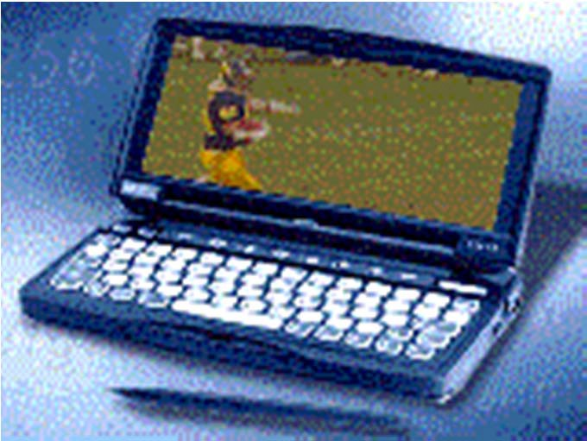
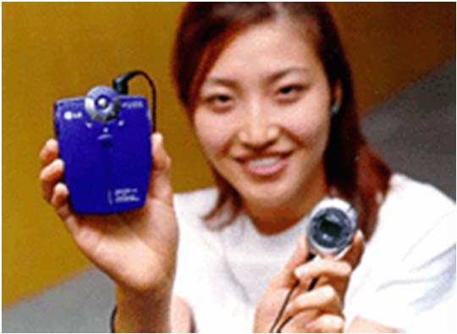
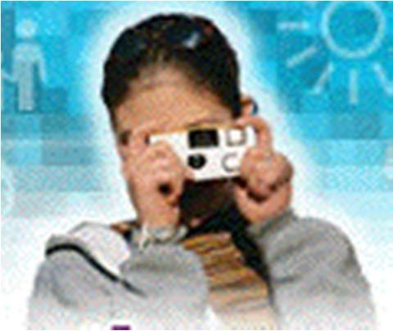
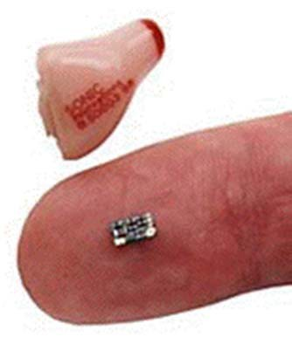
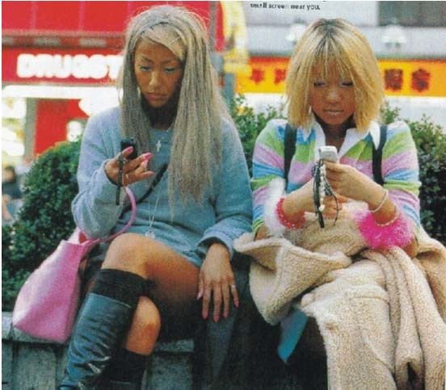
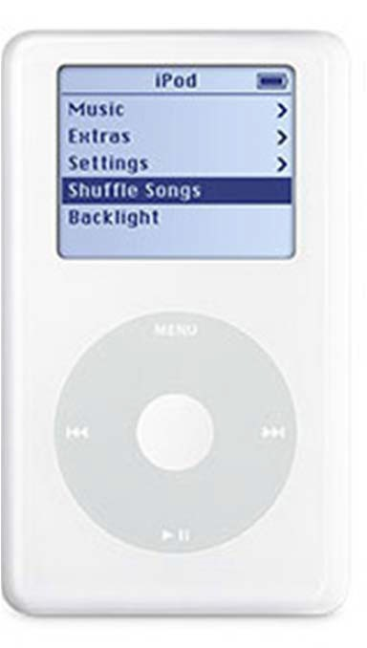
DSP/Speech Enabled Devices
Internet Audio
Digital Cameras
PDAs & Streaming Audio/Video
Hearing Aids
Cell Phones

Slide 18
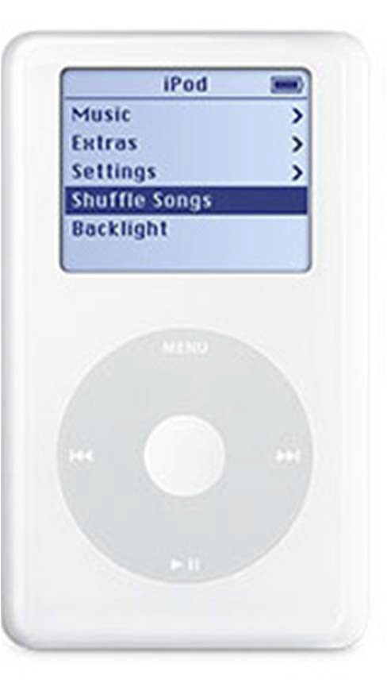
Apple iPod
stores music in MP3, AAC, MP4, wma, wav, … audio formats
compression of 11-to-1 for 128 kbps MP3
can store order of 20,000 songs with 30 GB disk
can use flash memory to eliminate all moving memory access
can load songs from iTunes store – more than 1.5 billion downloads
tens of millions sold
x[n]
y[n]
y_{c}(t)
Memory
Computer
D-to-A

Slide 19
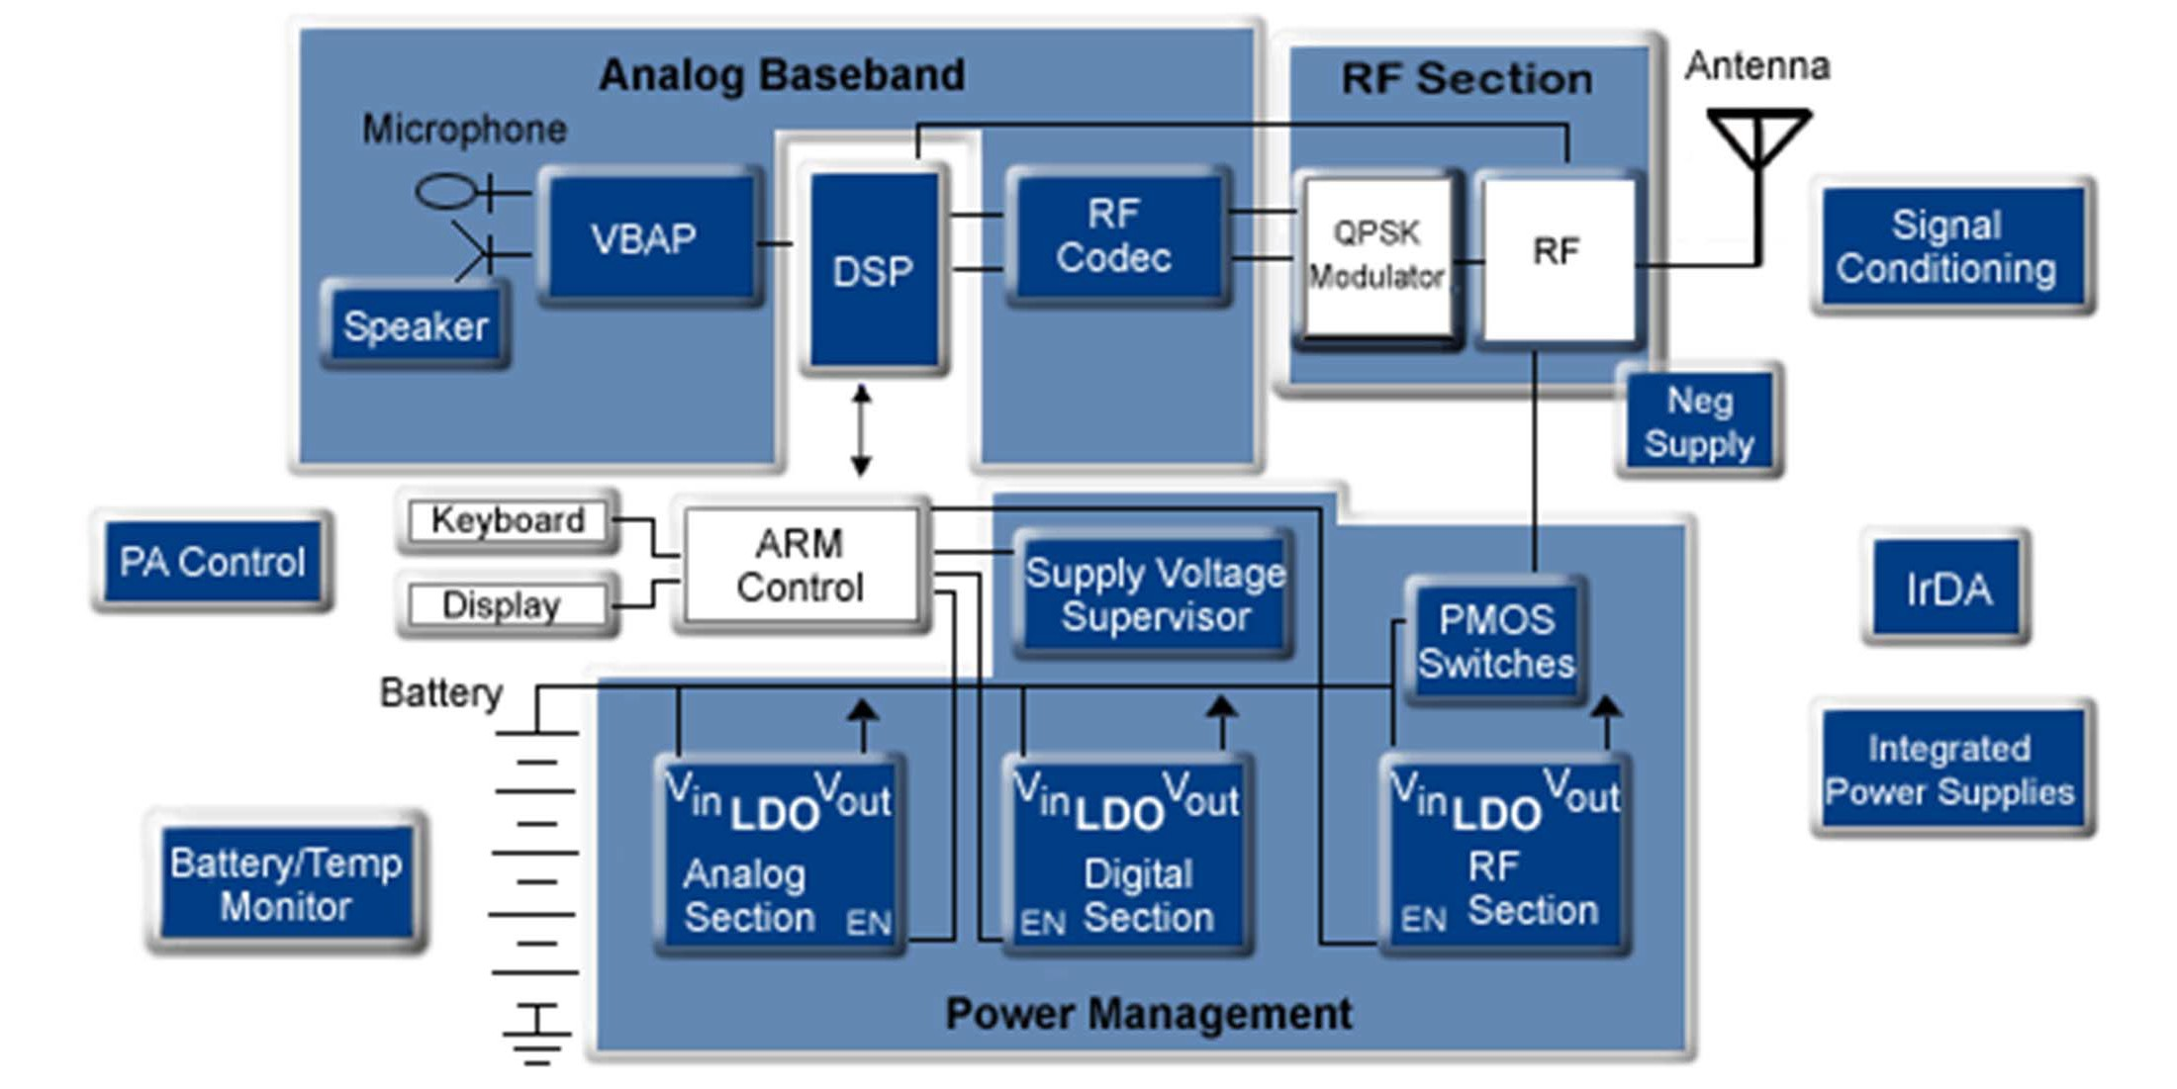
One of the Top DSP Applications
Cellular Phone

Slide 20
Digital Speech Processing
Need to understand the nature of the speech signal, and how dsp techniques, communication technologies, and information theory methods can be applied to help solve the various application scenarios described above
– most of the course will concern itself with speech signal processing — i.e., converting one type of speech signal representation to another so as to uncover various mathematical or practical properties of the speech signal and do appropriate processing to aid in solving both fundamental and deep problems of interest

Slide 21
Speech Signal Production
Speech Waveform
Message Source
Linguistic Construction
Articulatory Production
Acoustic Propagation
Electronic Transduction
M
W
S
A
X
Idea encapsulated in a message, M
Message, M, realized as a word sequence, W
Words realized as a sequence of (phonemic) sounds, S
Sounds received at the transducer through acoustic ambient, A
Signals converted from acoustic to electric, transmitted, distorted and received as X
Conventional studies of speech science use speech signals recorded in a sound booth with little interference or distortion
Practical applications require use of realistic or “real world” speech with noise and distortions

Slide 22
Speech Production/Generation Model
Message Formulation -7 desire to communicate an idea, a wish, a request, … => express the message as a sequence of words
Message Formulation
I need some string
Please get me some string Where can I buy some string
(Discrete Symbols)
Desire to Communicate
Text String
Language Code -7 need to convert chosen text string to a sequence of sounds in the language that can be understood by others; need to give some form of emphasis, prosody (tune, melody) to the spoken sounds so as to impart non-speech information such as sense of urgency, importance, psychological state of talker, environmental factors (noise, echo)
Language Code Generator
Text String
Phoneme string with prosody
(Discrete Symbols)
Pronunciation Vocabulary
(In The Brain)

Slide 23
Speech Production/Generation Model
Neuro-Muscular Controls -7 need to direct the neuro-muscular system to move the articulators (tongue, lips, teeth, jaws, velum) so as to produce the desired spoken message in the desired manner
Neuro- Muscular Controls
Articulatory motions
(Continuous control)
Phoneme String with Prosody
Vocal Tract System -7 need to shape the human vocal tract system and provide the appropriate sound sources to create an acoustic waveform (speech) that is understandable in the environment in which it is spoken
Vocal Tract System
Acoustic Waveform (Speech)
(Continuous control)
Articulatory Motions
Source control (lungs, diaphragm, chest
muscles)

Slide 24
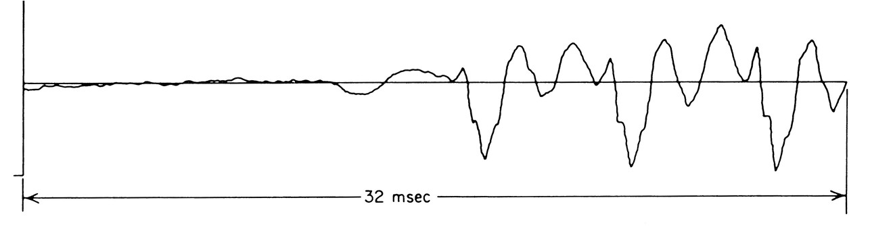
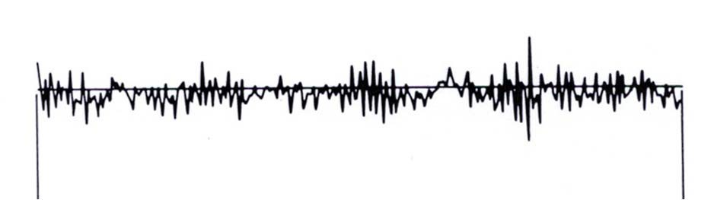
The Speech Signal
Background Signal
Pitch Period
Unvoiced Signal (noise- like sound)

Slide 25
Speech Perception Model
The acoustic waveform impinges on the ear (the basilar membrane) and is spectrally analyzed by an equivalent filter bank of the ear
Basilar Membrane Motion
Spectral Representation
(Continuous Control)
Acoustic Waveform
The signal from the basilar membrane is neurally transduced and coded into features that can be decoded by the brain
Neural Transduction
Sound Features (Distinctive Features)
(Continuous/Discrete Control)
Spectral Features
The brain decodes the feature stream into sounds, words and
sentences
Phonemes, Words, and Sentences
Language Translation
(Discrete Message)
Sound Features
The brain determines the meaning of the words via a message understanding mechanism
Message Understanding
Basic Message
(Discrete Message)
28
Phonemes, Words and Sentences

Slide 26
The Speech Chain
Text
Phonemes, Prosody Articulatory Motions
Message Formulation
Language Code
Neuro-Muscular Controls
Vocal Tract System
Discrete Input
Continuous Input
Acoustic Waveform
30-50
kbps
50 bps
200 bps
2000 bps
Transmission Channel
Information Rate
Phonemes, Words, Sentences
Semantics
Feature Extraction, Coding
Spectrum Analysis
Acoustic Waveform
Message Understanding
Language Translation
Neural Transduction
Basilar Membrane Motion
Discrete Output
Continuous Output
29

Slide 27
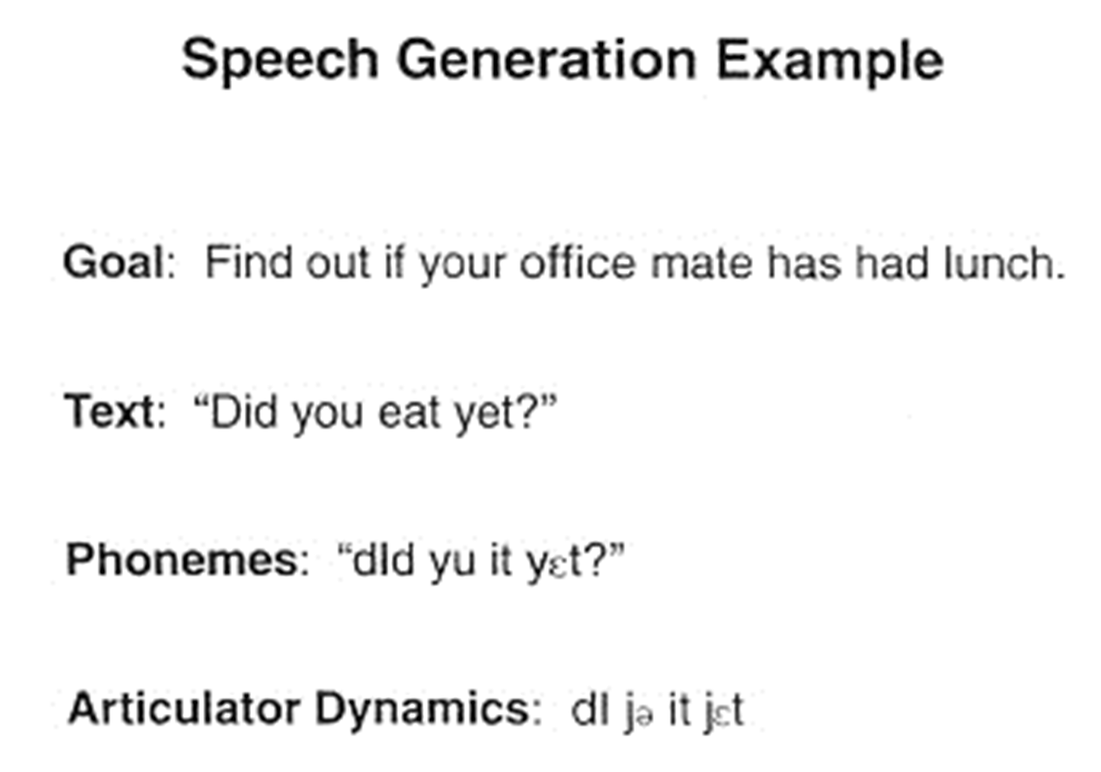
The Speech Chain

Slide 28
Speech Sciences
Linguistics: science of language, including phonetics, phonology, morphology, and syntax
Phonemes: smallest set of units considered to be the basic set of distinctive sounds of a languages (20-60 units for most languages)
Phonemics: study of phonemes and phonemic systems
Phonetics: study of speech sounds and their production, transmission, and reception, and their analysis, classification, and transcription
Phonology: phonetics and phonemics together
Syntax: meaning of an utterance

Slide 29



The Speech Circle
Voice reply to customer
Customer voice request
“What number did you want to call?”
Text-to-Speech Synthesis
TTS
ASR
Automatic Speech Recognition
Data
What’s next?
“Determine correct number”
Words spoken
“I dialed a wrong number”
DM & SLG
SLU
Dialog Management (Actions) and Spoken Language Generation
Spoken Language Understanding
Meaning
“Billing credit”
(Words)

Slide 30
Information Rate of Speech
from a Shannon view of information:
message content/information--2**6 symbols (phonemes) in the language; 10 symbols/sec for normal speaking rate => 60 bps is the equivalent information rate for speech (issues of phoneme probabilities, phoneme correlations)
from a communications point of view:
speech bandwidth is between 4 (telephone quality) and 8 kHz (wideband hi-fi speech)—need to sample speech at between 8 and 16 kHz, and need about 8 (log encoded) bits per sample for high quality encoding => 8000x8=64000 bps (telephone) to 16000x8=128000 bps (wideband)
1000-2000 times change in information rate from discrete message symbols to waveform encoding => can we achieve this three orders of magnitude reduction in information rate on real speech waveforms?
33

Slide 31
Information Source
Human speaker—lots of variability
Measurement or Observation
Acoustic waveform/articulatory positions/neural control signals
Signal Representation
Signal Processing
Purpose of Course
Signal Transformation
Extraction and Utilization of Information
Human listeners, machines
34

Slide 32
Digital Speech Processing
DSP:
obtaining discrete representations of speech signal
theory, design and implementation of numerical procedures (algorithms) for processing the discrete representation in order to achieve a goal (recognizing the signal, modifying the time scale of the signal, removing background noise from the signal, etc.)
Why DSP
reliability
flexibility
accuracy
real-time implementations on inexpensive dsp chips
ability to integrate with multimedia and data
encryptability/security of the data and the data representations via suitable techniques
35

Slide 33
Hierarchy of Digital Speech Processing
Representation of Speech Signals
represent signal as output of a speech production model
Waveform Representations
Parametric Representations
preserve wave shape through sampling and quantization
Excitation Parameters
Vocal Tract Parameters
pitch, voiced/unvoiced, noise, transients
spectral, articulatory
36

Slide 34
Information Rate of Speech
Data Rate (Bits Per Second)
200,000
60,000
20,000
10,000
500
75
LDM, PCM, DPCM, ADM
Analysis- Synthesis Methods
Synthesis from Printed Text
(No Source Coding)
(Source Coding)
Waveform Representations
Parametric Representations

Slide 35
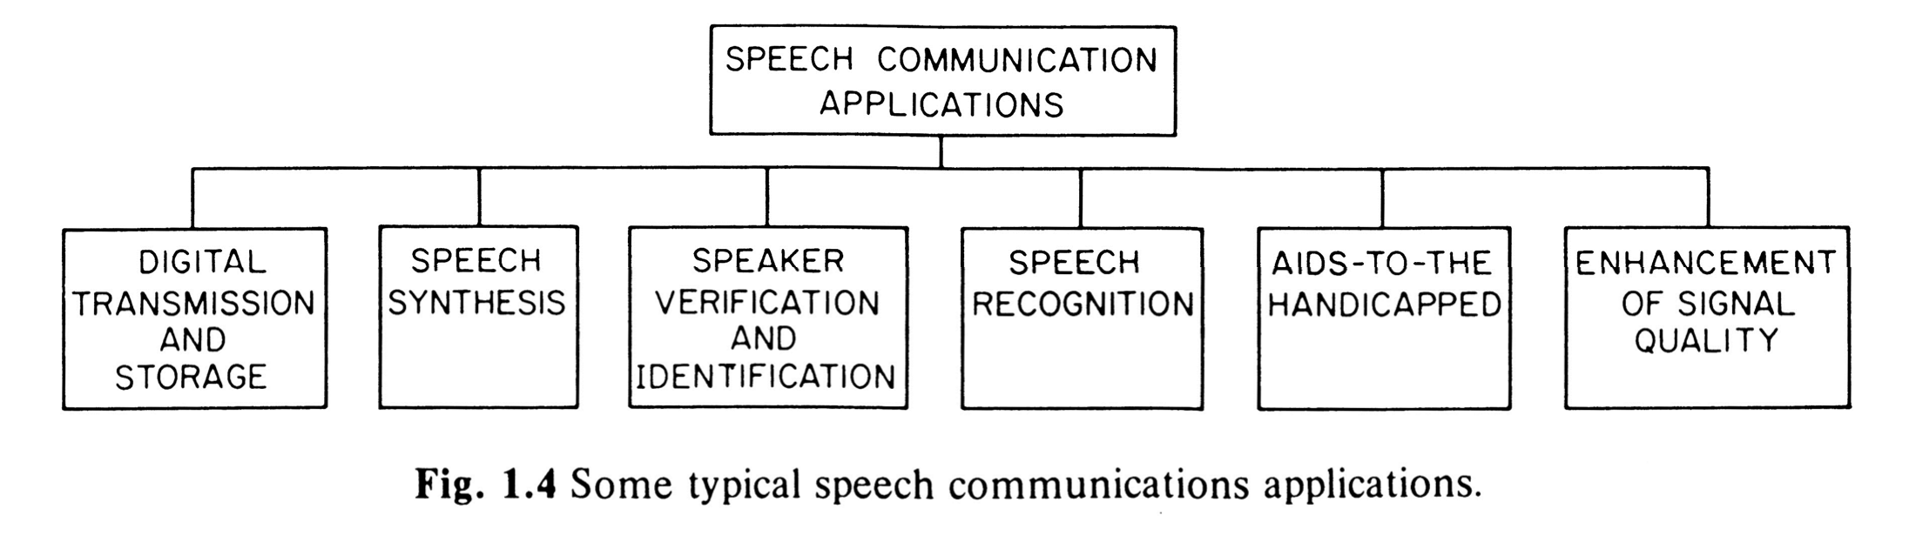
Speech Processing Applications
Cellphones
VoIP
Vocoder
Noise and echo removal, alignment of speech and text
Dictation, command- and- control, agents, NL voice dialogues, call centers, help desks
Readings for the blind, speed-up and slow- down of speech rates
Messages, IVR, call centers, telematics
Secure access, forensics
Conserve bandwidth, encryption, secrecy, seamless voice and data

Slide 36
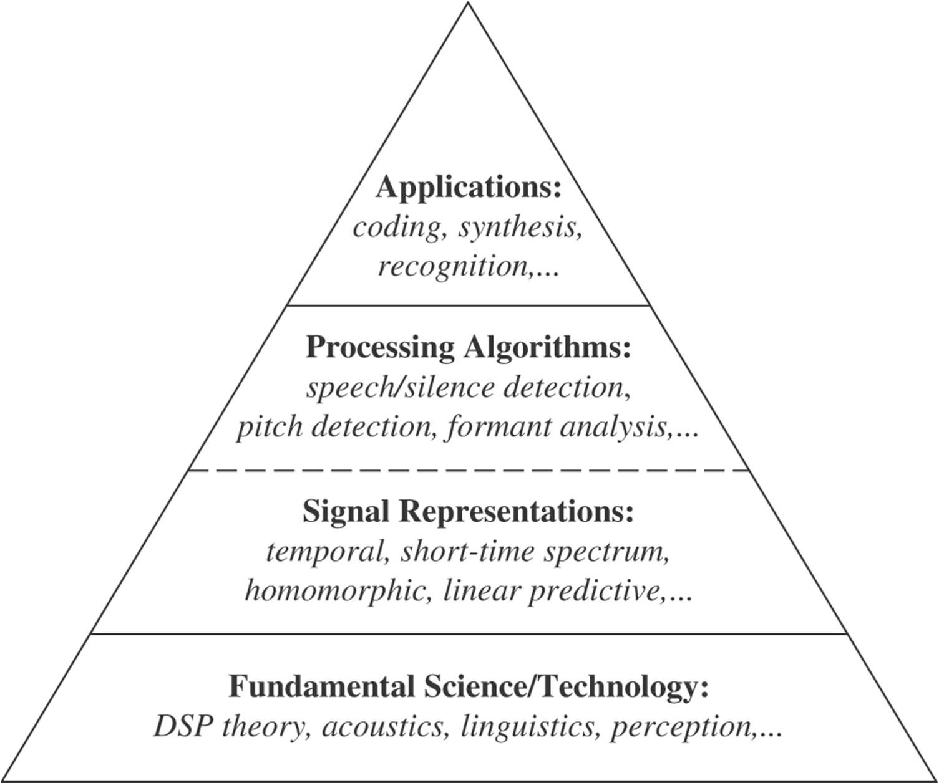
The Speech Stack

Slide 37
What We Will Be Learning
review some basic dsp concepts
speech production model—acoustics, articulatory concepts, speech production models
speech perception model—ear models, auditory signal processing, equivalent acoustic processing models
time domain processing concepts—speech properties, pitch, voiced- unvoiced, energy, autocorrelation, zero-crossing rates
short time Fourier analysis methods—digital filter banks, spectrograms, analysis-synthesis systems, vocoders
homomorphic speech processing—cepstrum, pitch detection, formant estimation, homomorphic vocoder
linear predictive coding methods—autocorrelation method, covariance method, lattice methods, relation to vocal tract models
speech waveform coding and source models—delta modulation, PCM, mu-law, ADPCM, vector quantization, multipulse coding, CELP coding
methods for speech synthesis and text-to-speech systems—physical models, formant models, articulatory models, concatenative models
methods for speech recognition—the Hidden Markov Model (HMM)
42

